Slide 1


Employee Attrition Prediction
Group 1 1. Prakhar Rai
2. Prakhar Tiwari
3. Prajesh Singh Meena
4. Krrish Kumar
5. Hemang Singh
6. Divyansh Yadav

Slide 2
Problem Statement
High employee turnover costs companies significantly: increased hiring expenses, workflow disruptions, and low morale. Predicting attrition is key.
Key Challenges
Our Goal
High turnover costs
Develop an ML system to predict at-risk employees, enabling HR to take preventive action.
Disrupted workflows
Low team morale

Slide 3
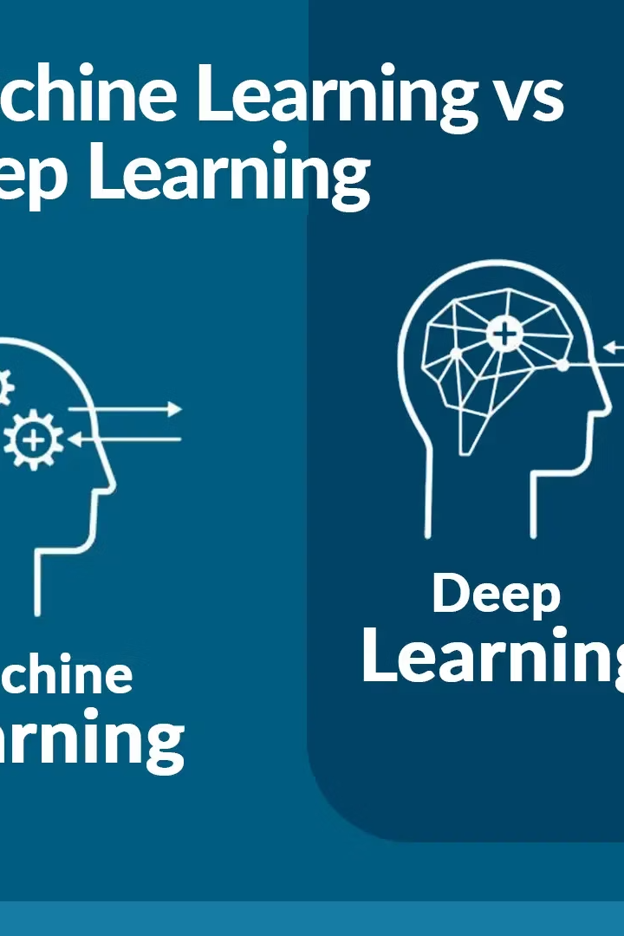
Introduction to Attrition Prediction
What is Attrition?
Contributing Factors
Employees voluntarily leaving the organization.
Job dissatisfaction, low income, work-life imbalance.
ML Role
Analyze historical data, predict attrition, retain talent.

Slide 4
Project Objectives
Identify Key Factors
Build Accurate ML Model
Evaluate Model Metrics
Uncover drivers of employee attrition.
Develop a precise prediction system.
Assess performance with suitable metrics.
Provide Retention Insights
Offer strategies to improve employee retention.

Slide 5
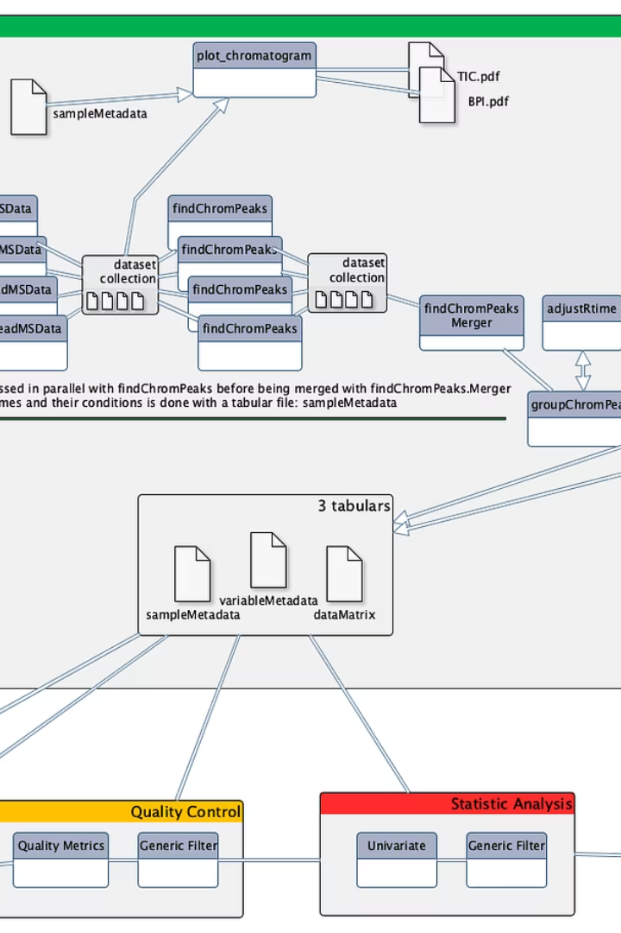
Data Preprocessing Steps
1
Handle Missing Values
2
Encode Categorical Data
3
Scale Numerical Data
Checked and imputed missing data.
Label Encoding and One-Hot Encoding.
Used StandardScaler for uniformity.
4
Split Data
80% training, 20% testing sets.

Slide 6
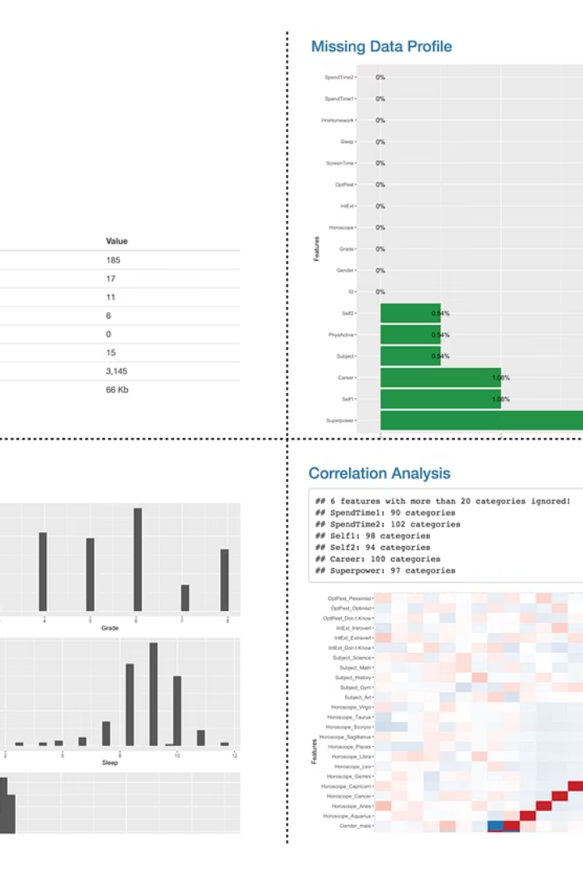
Dataset Overview
IBM HR Analytics Employee Attrition Dataset from Kaggle.
Records
Features
~1470 employee entries
Age, Monthly Income
Job Role, Overtime
Satisfaction, etc.
Target Variable
Attrition (Yes/No)

Slide 7





Feature Selection and Engineering
Remove Irrelevant Columns
Correlation Matrix
Overtime
Identified important features.
Significant impact on attrition.
Eliminated Employee ID and similar.
Job Satisfaction
Monthly Income
Crucial for employee retention.
Financial factors play a role.

Slide 8
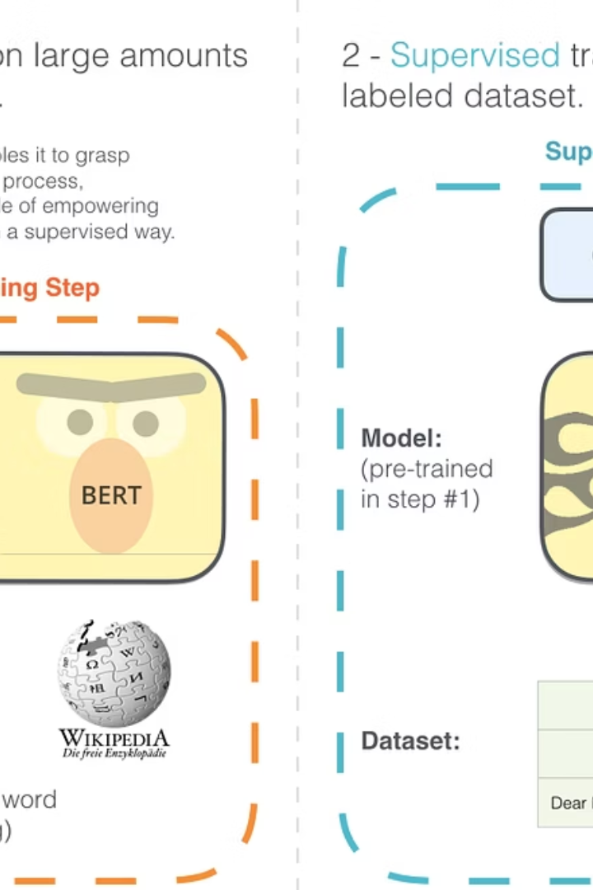




Methodology: ML Models
Logistic Regression
Decision Tree
Random Forest
Tree-based classification.
Ensemble of decision trees.
Baseline classification model.
Support Vector Machine
Effective for complex data.

Slide 9

Model Training & Evaluation Process
Train Models
Used 80% of the dataset.
Test Performance
Evaluated on 20% of data.
Hyperparameter Tuning
GridSearchCV for optimization.
Cross-Validation
Applied to avoid overfitting.

Slide 10
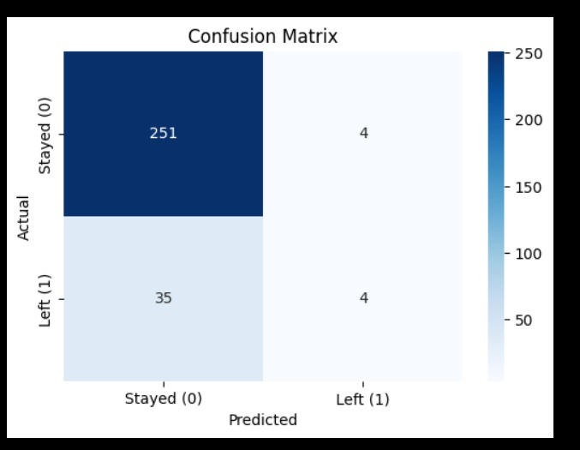
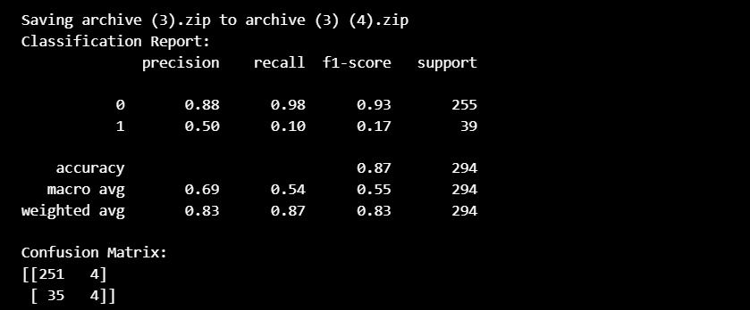
Performance Metrics

Slide 11
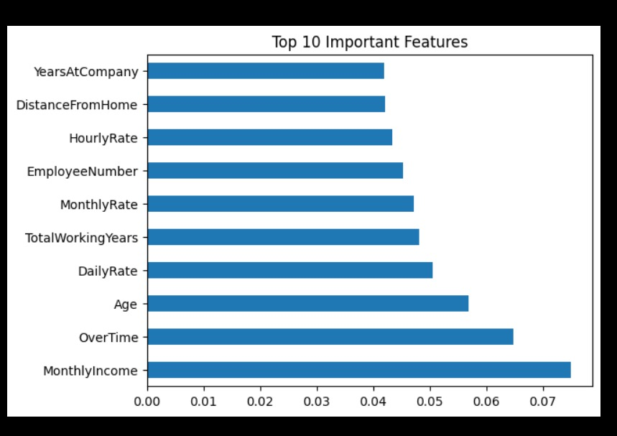
Output and Insights
Key attrition drivers identified: overtime, low income, and low job satisfaction. A confusion matrix validates prediction quality. Bar charts visualize feature-based attrition, providing actionable insights for HR.

Slide 12
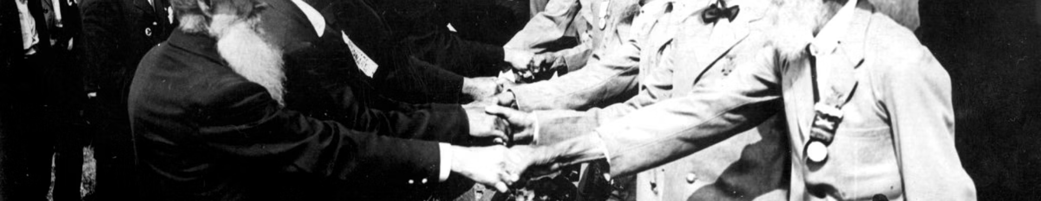
Business Impact
Early Identification
Informed Decisions
Cost Reduction
Improved Engagement
Lower turnover and training expenses
Identify at-risk employees proactively
Enable data-driven HR strategies
Boost employee satisfaction

Slide 13

Limitations & Future Enhancements
Dataset Limitations
Diverse Datasets
Real-time Integration
Deep Learning
Utilize larger, varied data sources
Explore advanced models for accuracy
Single-company data, potential biases
Embed predictions in HR systems

